Slide 1
Introduction to Cloud

Slide 2
AGENDA
Why Move to the Cloud
Understanding Cloud Computing
Cloud Infrastructure
Cloud Security
Cloud Cost Management

Slide 3
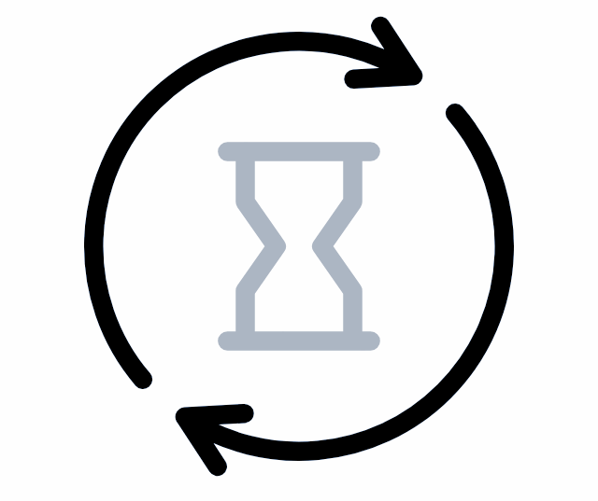
Let’s rollback in Time

Slide 4

The First Wave…
On-Prem
Hardware Defined Data Center (HDDC)
Storage
Network Switches
Racks
Servers/machines/nodes
Power Supply
Cables
PDU's
Cooling System
Security
Operators/Staff/Maintenance
Firewalls
Routers
and many more…
Availability of Data Center and Resources
CAPEX (Upfront Cost)
Long waiting time (months to year)
Capacity planning challenge
Poor Resource Utilization (30% - 40%) - 1:1
No business focus
Availability, Reliability, and Fault Tolerance are organization’s responsibility

Slide 5
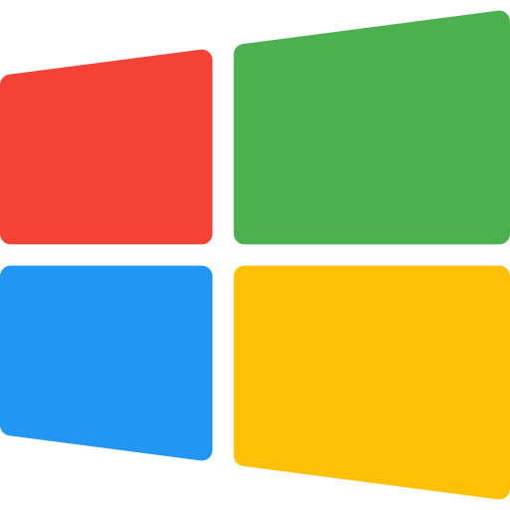



The Second Wave…
On-Prem
Hardware Defined Data Center (HDDC)
Virtualization
Software Defined Data Center (SDDC)
HYPERVISOR
software that creates and runs virtual machines
HOST MACHINE
Resource Utilization becomes 1:N

Slide 6

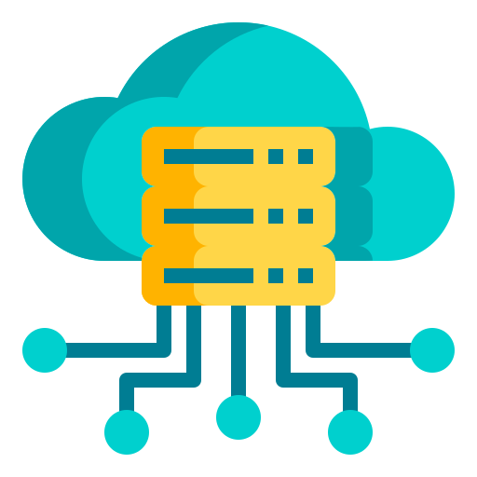

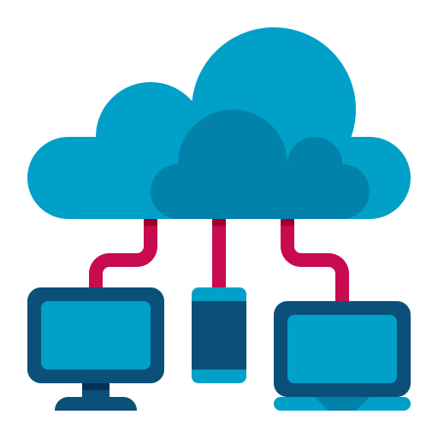



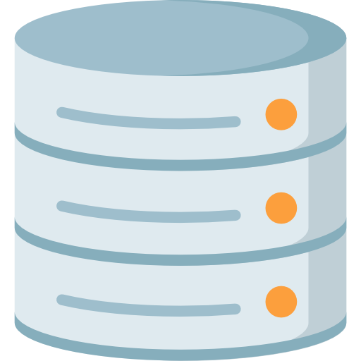
The Third Wave…
On-Prem
Hardware Defined Data Center (HDDC)
Virtualization
Software Defined Data Center (SDDC)
Cloud Computing
Pay as you go
On Demand - Pay-as-you-go
CAPEX to OPEX cost transition
Capacity auto-scaling
INTERNET
No waiting time
Management
APPLICATION
SECURITY
Go global in minutes
SERVICE
Business focused
STORAGE
Highly Available, Reliable & Fault Tolerant

Slide 7

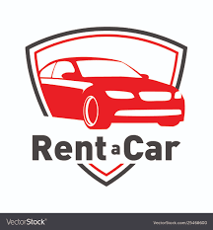

On-prem vs IaaS vs Serverless
On-Prem
(Buy a Car)
IaaS
(Rent a Car)
Serverless
(Pay-as-you-go)

Slide 8
On-prem vs IaaS vs Serverless
Private Network | Cloud Computing
On-Prem | IaaS | Serverless
Servers that are physically located on the company's premises | It is pay-as-you-go service for on demand basic computation, storage, and networking resources | Apps are launched only as needed as an event triggers app code to run
We are fully responsible for all aspects of security | Helps us to reduce maintenance of on-premises data centres | Enables developers to build applications faster by eliminating the need for them to manage infrastructure
Need specialists for maintenance | Each resource is offered as a separate service component and we only pay for resource we use | Serverless is typically used as a synonym for Function-as-a-Service
Complete control over data, and based on traffic flow, it may be less expensive | Save money on hardware costs and gain real-time business insights | We only pay for compute resources when we run our code

Slide 9
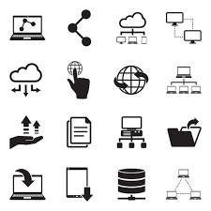


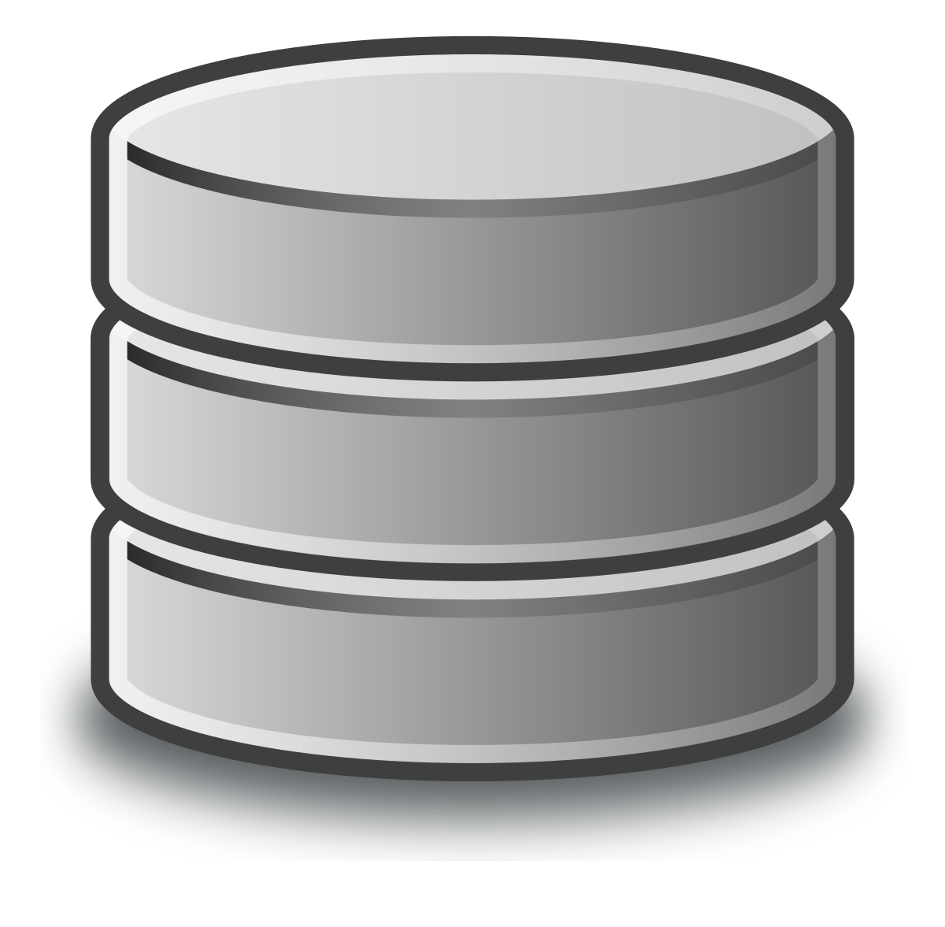
Processing Data on On-Prem
On-Prem System
Data Gathering
Data Sources
Compute
Storage
For better performance, either increase the number of Servers or we can increase the number of CPUs & Storage in servers

Slide 10
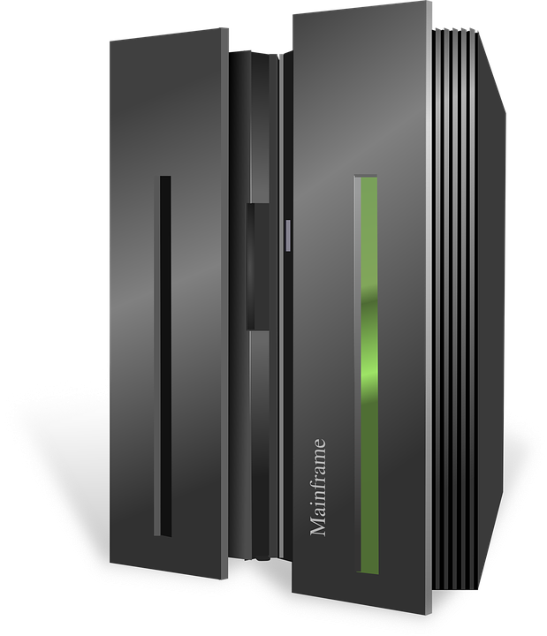

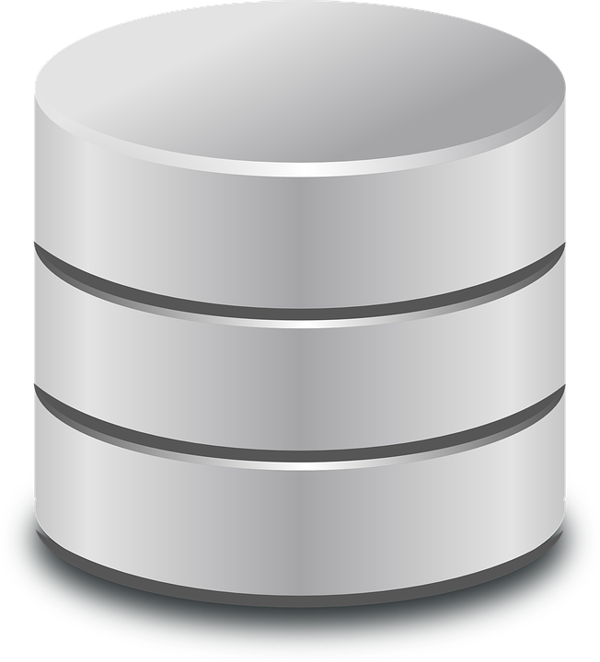

Processing Data On Cloud
On-Prem System
Cloud System
Sending data using Queues in Cloud
Compute
Storage
For better performance, we can either increase the number of devices or we can increase the no. of CPUs & Storage

Slide 11

What is Cloud Computing?

Slide 12
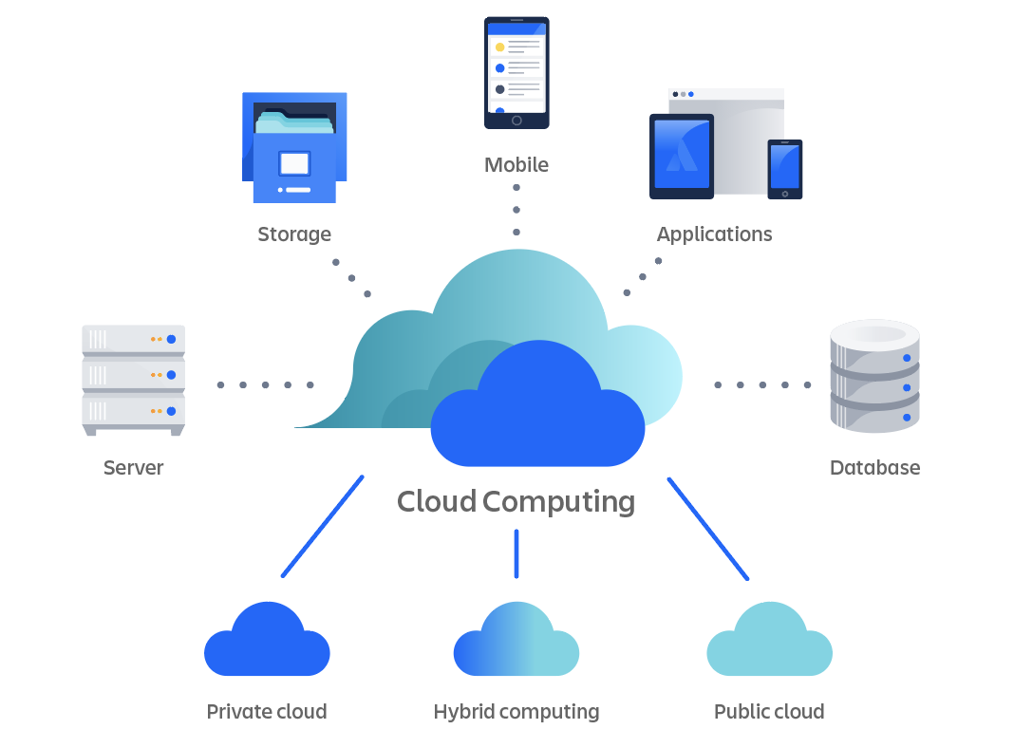
What is Cloud Computing?
Cloud computing refers to the on-demand availability of computer system resources, particularly data storage and computational power, without the user having to manage them directly. Functions in large clouds are frequently dispersed across numerous locations, each of which is a data centre.
Source: Atlassian

Slide 13

What is Cloud Computing?
“ It is a style of computing where scalable and elastic IT-enabled capabilities are provided as a service to external customers using Internet technologies. Public cloud computing uses cloud computing technologies to support customers that are external to the provider’s organization. Using public cloud services generates the types of economies of scale and sharing of resources that can reduce costs and increase choices of technologies.”

Slide 14



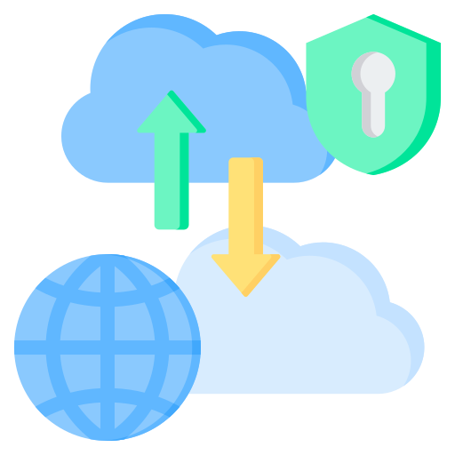
Various types of Cloud Computing
PUBLIC CLOUD
(Provide resources which are over the internet)
PRIVATE CLOUD
(Provide resource which are available to an organization)
HYBRID CLOUD
(Mixes at least one private cloud to one or more public clouds)

Slide 15


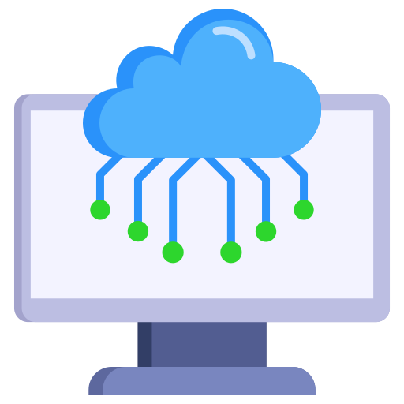





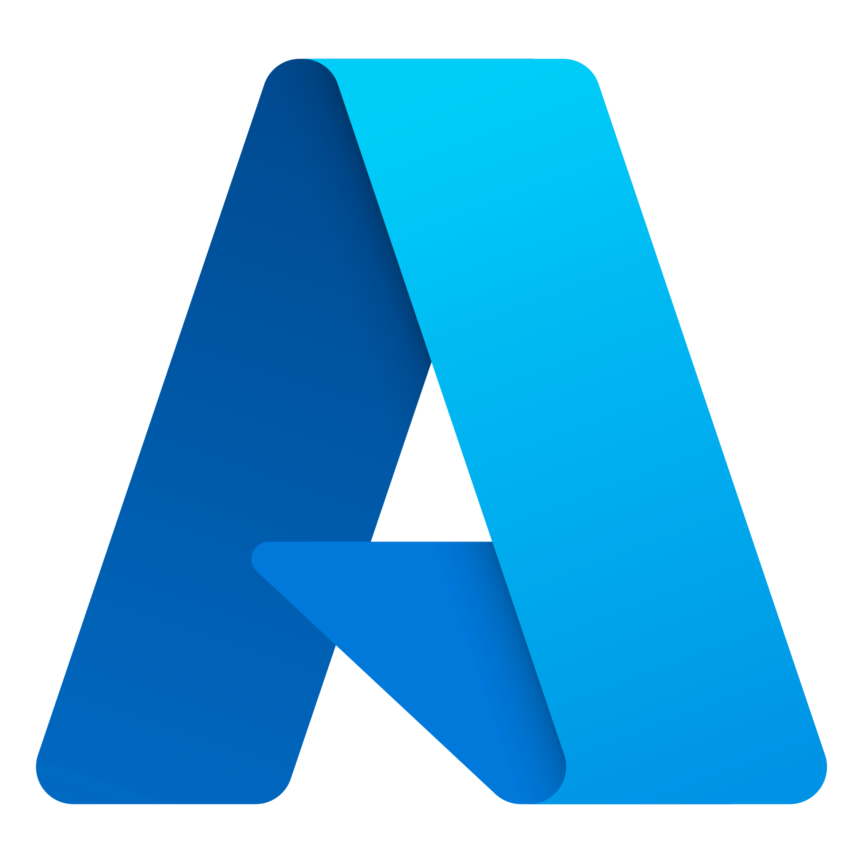
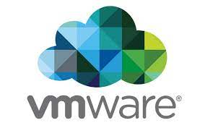
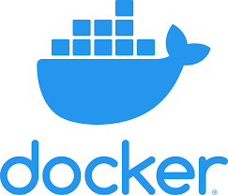


Various Cloud Models
SaaS
(Software-as-a-Service)
IaaS
(Infrastructure-as-a-Service)
PaaS
(Platform-as-a-Service)

Slide 16
Why do we need Cloud Computing?

Slide 17


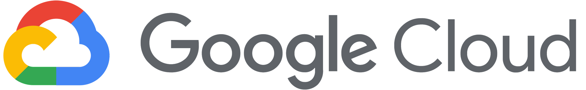



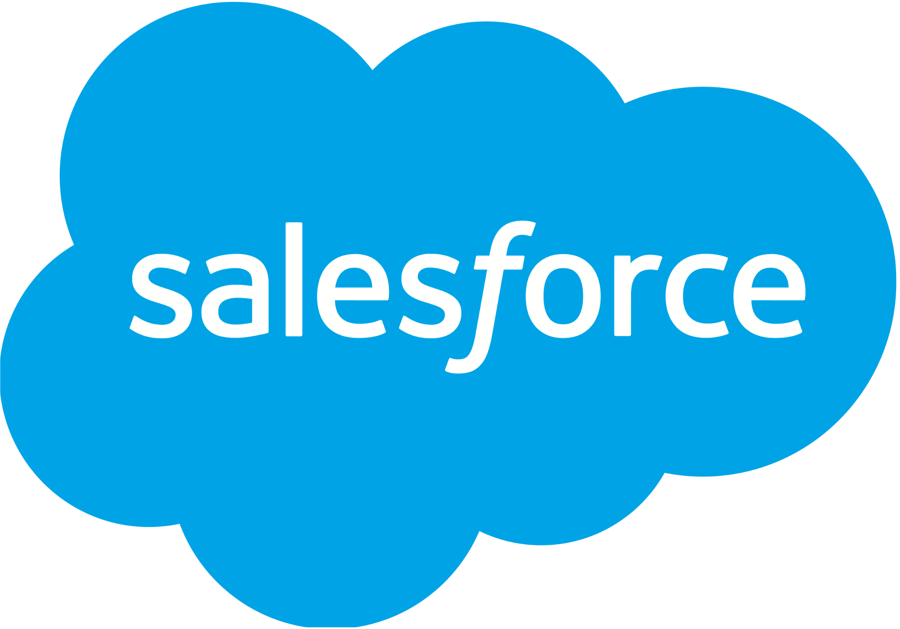

Amazon, Microsoft, & Google Dominate Cloud Market
As per statista, worldwide market share of leading cloud infrastructure service providers in Q3 2022
34%
21%
11%
5%
Cloud Infrastructure Service revenues In the 12 months ended September 2022 were
$217 BILLION
3%
3%
2%

Slide 18
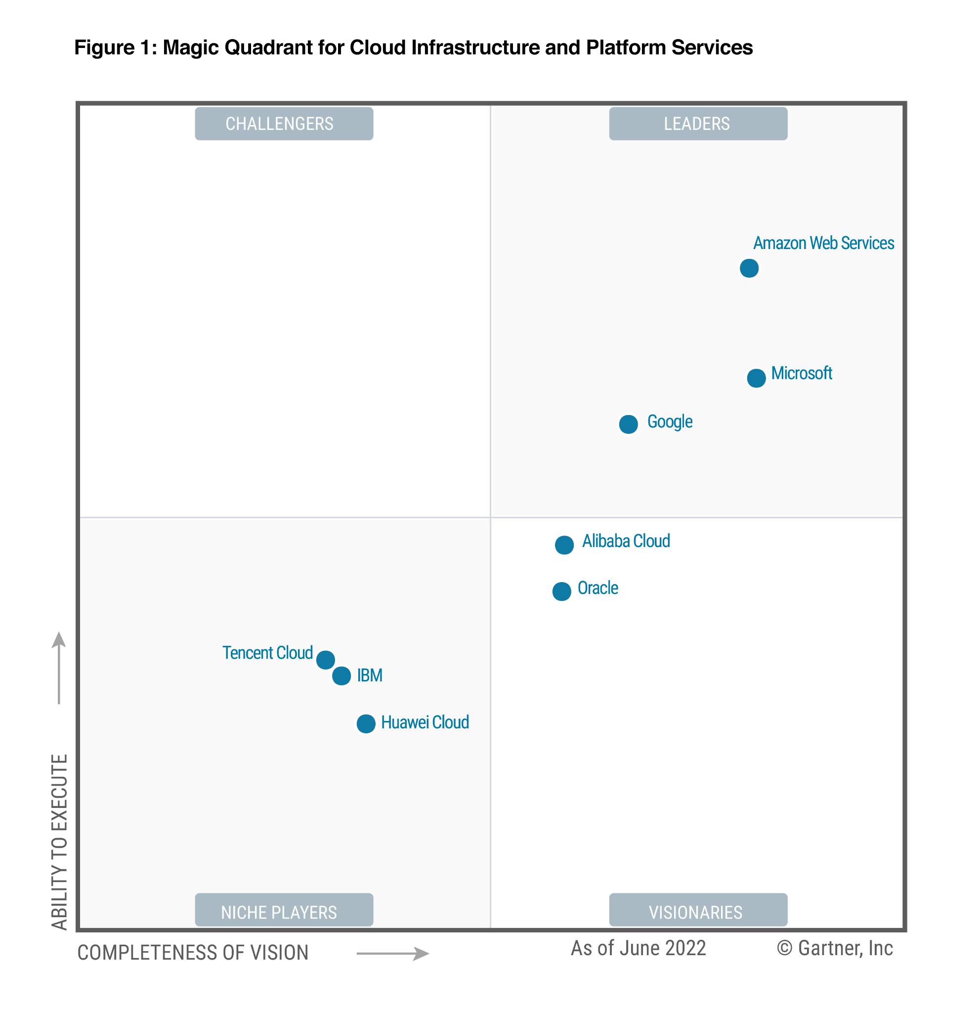
Why AWS or Azure or GCP?

Slide 19
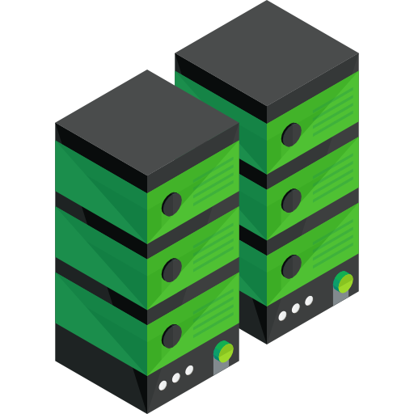
Cloud Physical Architecture
DISASTER RECOVERY
AVAILABILITY ZONE 2
AVAILABILITY ZONE 1
One or More Data Centers
One or More Data Centers
Diverse fiber paths connecting Availability Zones
AVAILABILITY ZONE 3
One or More Data Centers
Cloud Region

Slide 20
Cloud Security

Slide 21
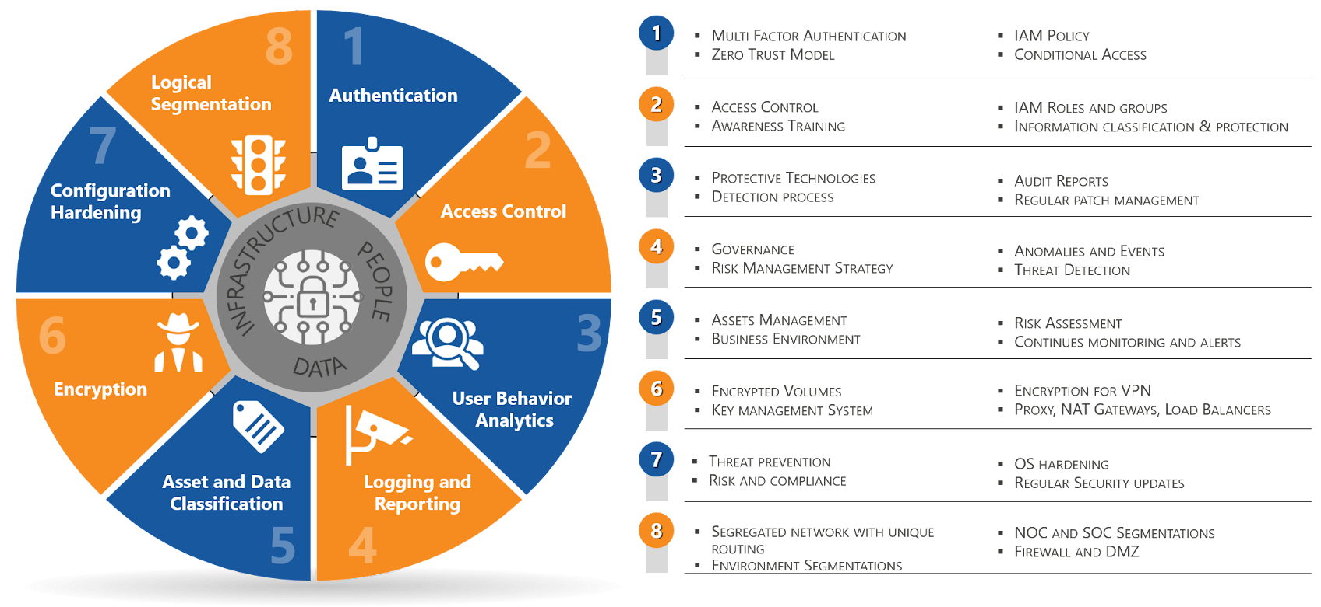
Cloud Security

Slide 22
Why we need cloud security?
Cloud computing is being used for more than two decades. Still, several businesses find security as a challenge to handle.
Almost, everyone is on cloud
It’s a shared responsibility
For many its still new, so much to explore
Multi tenancy make resource prone to attacks
Cloud providers are not omnipotent
Data security is a big concern
and many more …

Slide 23
Exploited Vulnerabilities are preventable
Zero-day exploits that take advantage of OS/app vulnerabilities unknown to the victim
Exploits that take advantage of known vulnerabilities in unpatched applications
Exploits that take advantage of known vulnerabilities in unpatched OS versions
45%
have experienced one or more of these three types of exploits

Slide 24
Most Crucial aspects of Cloud Security
Security in the cloud consists of 4 areas:
Data Protection
Infrastructure Protection
Privilege Management
Detective Controls

Slide 25
Cloud Security Dissection
It’s a shared responsibility
IAM: Principle of Least Privilege
Network Security
Application Security
Data Security
Logging and Monitoring
Cloud Security Automation

Slide 26
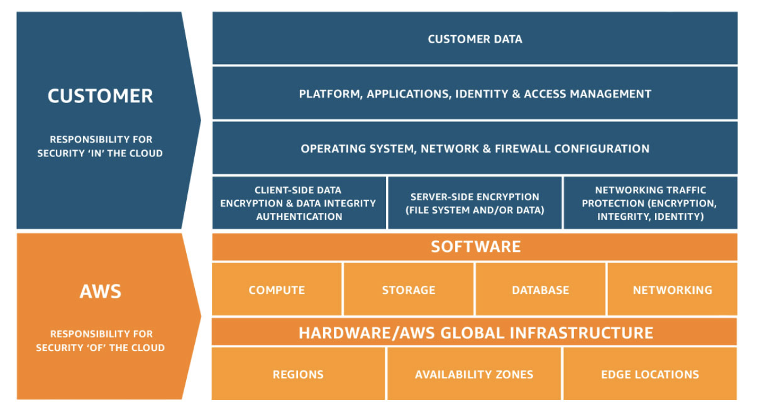
Shared Responsibility

Slide 27
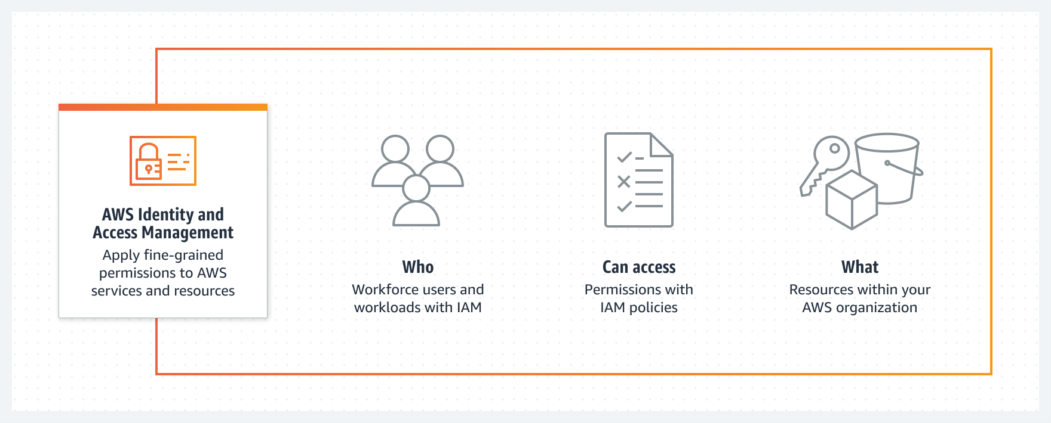
AWS Identity and Access Management

Slide 28
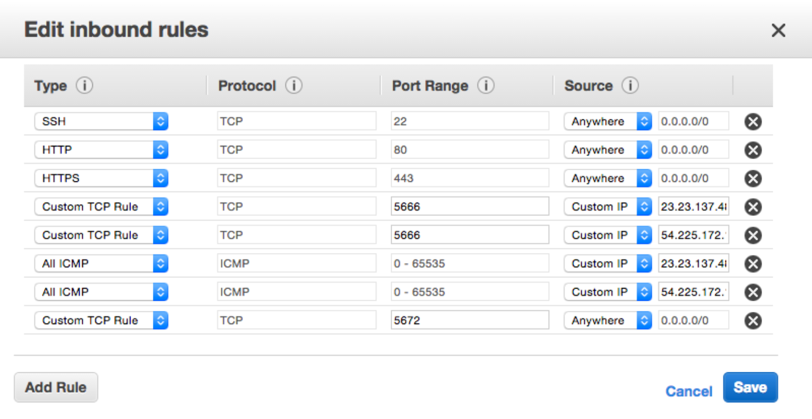
AWS security group
A security group acts as a virtual firewall that controls the traffic for one or more instances.

Slide 29
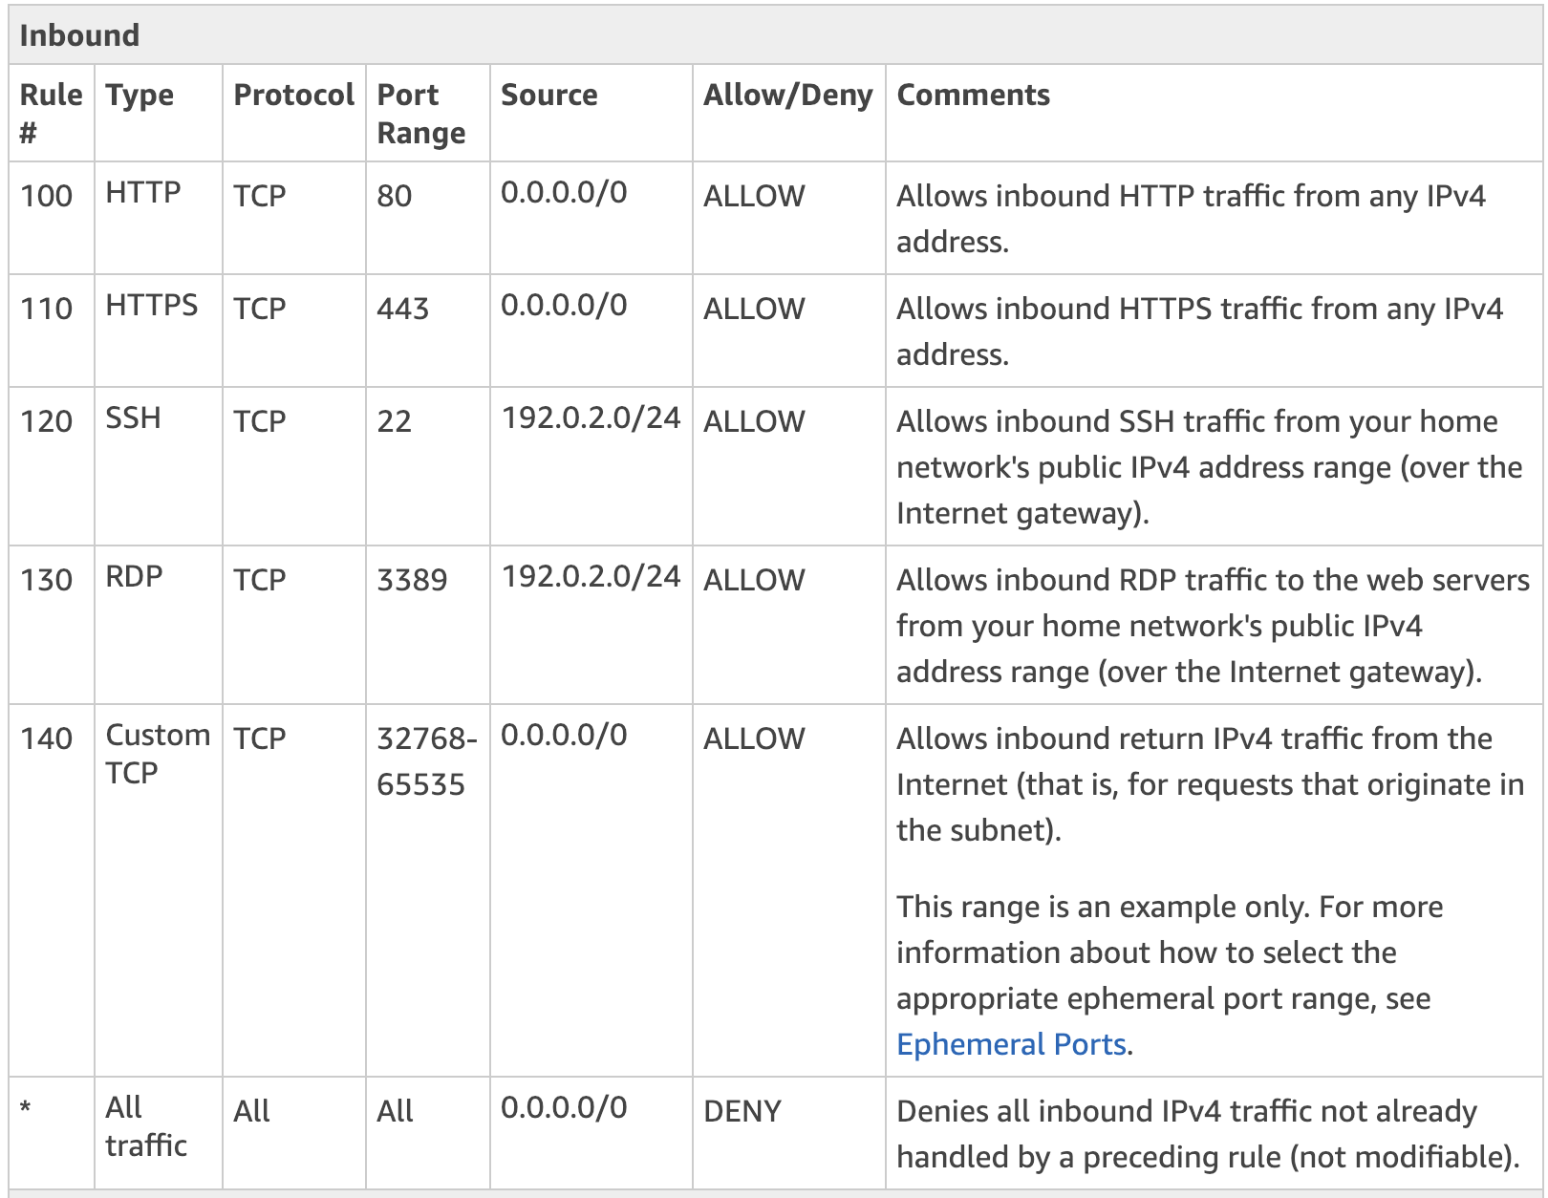
AWS security group

Slide 30
Data Protection
Data protection refers to protecting data while in-transit (as it travels to and from Amazon S3) and at rest (while it is stored on disks in Amazon S3 data centers). You can protect data in transit by using SSL or by using client-side encryption
Use Server Side Encryption
Use Client Side Encryption
You request Amazon S3 to encrypt your object before saving it on disks at its data centers and decrypt it for you as you download these objects
You can encrypt data at client-side and upload the encrypted data to Amazon S3 - encryption/decryption are handled by client

Slide 31
Logging
Whom to give log access
What to log
Where to store
Log duration
Secured cloud logging service - Sumo Logic, Alert Logic
Cloudtrail, Cloudwatch, VPC flow logs in AWS

Slide 32
Cloud Cost Management

Slide 33
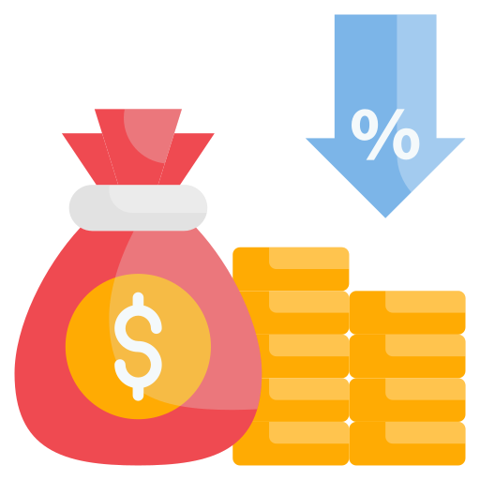
Cloud Cost Management
Cloud Cost Management is the process of optimizing and controlling cloud expenses.
It ensures efficient utilization of cloud resources while minimizing unnecessary spending.

Slide 34
Key Objectives
OPTIMIZE COSTS
BUDGET CONTROL
COST VISIBILITY
RESOURCE GOVERNANCE
Identify cost-saving opportunities without compromising performance
Set and monitor budgets to prevent unexpected expenses
Gain clear insights into cloud usage and expenditure
Implement policies to manage resource allocation effectively

Slide 35
Cost Optimization Strategies
Right-Sizing | Reserved Instances | Spot Instances
Match cloud resources to actual workload requirements | Leverage discounted pricing by committing to long-term usage | Utilize spare capacity at significantly reduced costs
Identify and eliminate over-provisioned instances | Ideal for stable and predictable workloads | Suitable for fault-tolerant, non-critical workloads

Slide 36
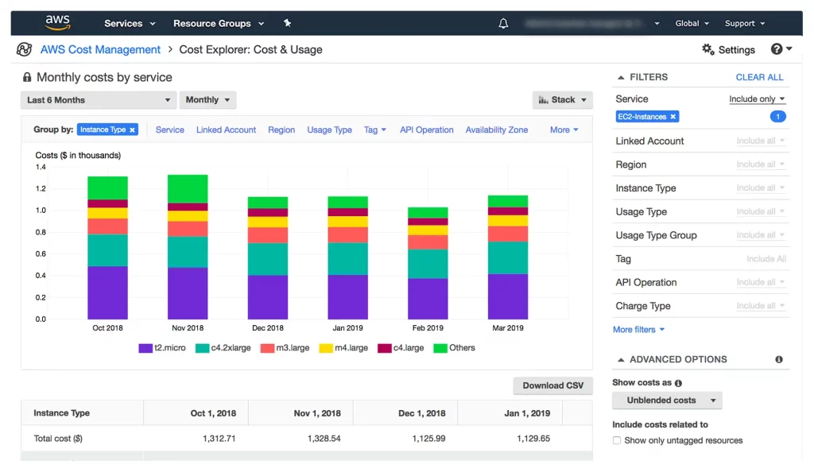
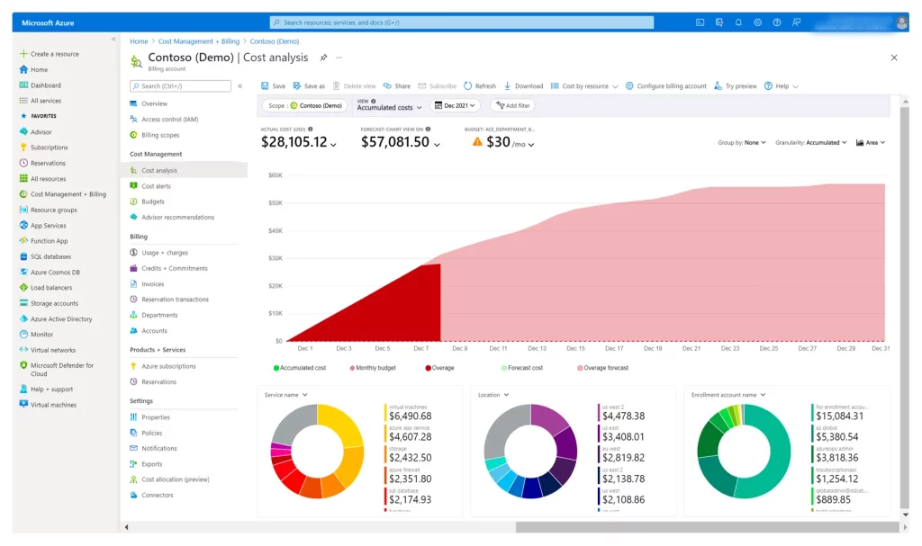
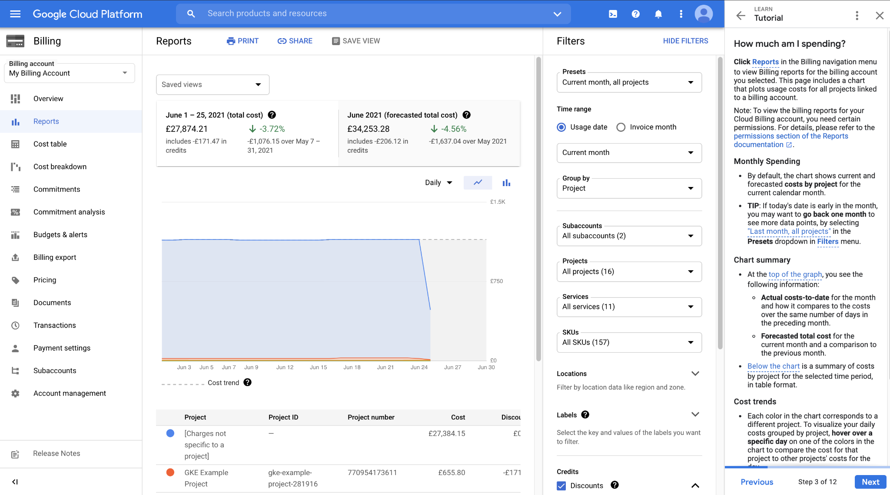
Cloud Cost Monitoring Tools
AWS Cost Explorer
Azure Cost Management + Billing
Google Cloud Billing
Third-Party Solutions

Slide 37


Case Study: Foursquare
Foursquare Checks-In to 53% Cost Savings with AWS
Foursquare is a technology company that informs business decisions through a deep understanding of location intelligence. The company’s mobile apps, Foursquare and Swarm, are used monthly by more than 50 million people who have left more than 87 million tips and checked in more than 10 billion times.
“Using AWS helps us scale up as our data grows, and as the complexity of our queries increases. And we can spin up nodes dynamically whenever we need them, whether we’re launching a new feature or increasing capacity.”
Jon Hoffman Software Engineer, Fourquare

Slide 38
Questions

